Slide 1
W266 Natural Language Processing
Week 6: Language Modeling

Slide 2
Peeking ahead...
Week 1- 2: NN Basics & Training
Week 3: Classification & Sentiment
Week 4: Part of Speech + Parsing
Week 5: Convolutional Neural Networks (CNNs)
Week 6 - 7: Language Models
Project Proposal Past Due
Week 8: Machine Translation
Week 9: Advanced MT: Transformers & Transfer Learning
Week 10: Entities/Information Extraction
Week 11: Summarization and a touch of question answering
Week 12: Document Classification
Week 13: Information Retrieval

Slide 3
Announcements
Assignment 4 (CNN) - released this past Saturday 02/06
Due Sunday, Feb 14 (Tuesday 02/16 if you use late days)
Assignment 5 (LM) to be released Saturday 02/13.
Paper reading sessions:
Underspecification Presents Challenges for Credibility in Modern Machine Learning
Zack: This Thursday 2/11 5:40 pm PST
How much knowledge can you pack into the parameters of a language model?
Mark: Next Thursday 2/18 5:40 pm PST
Project Proposals - Past Due!
Concerns?

Slide 4
Mid-term Course Evaluations
Please take a moment to provide us with feedback. We’re always trying to improve the class.
Midterm course evaluations are available here.

Slide 5
Language Models (2 Weeks): Agenda
Key Learnings Review & Beyond
Language Models: Motivation & Intuition
Neural Language Models 1: Simple Neural LM & Optimizations
Neural Language Models 2: Recurrent Neural Nets
Application of LMs: Context-aware embeddings with ELMO
Outlook: Transfer Learning with BERT, OpenAI GPT & Sentence Embeddings with USE
~ Week 6
~ Week 7

Slide 6
Key Learnings Review

Slide 7
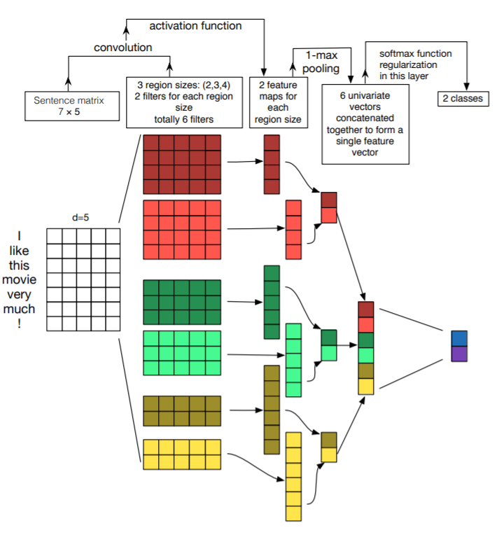
Sentence Classification with CNNs
Discussion:
Embeddings
Convolution Layer
Pooling Layer
Affine plus Softmax
Another View: Zhang/Wallace (UT Austin, 2014, https://arxiv.org/pdf/1510.03820.pdf )

Slide 8
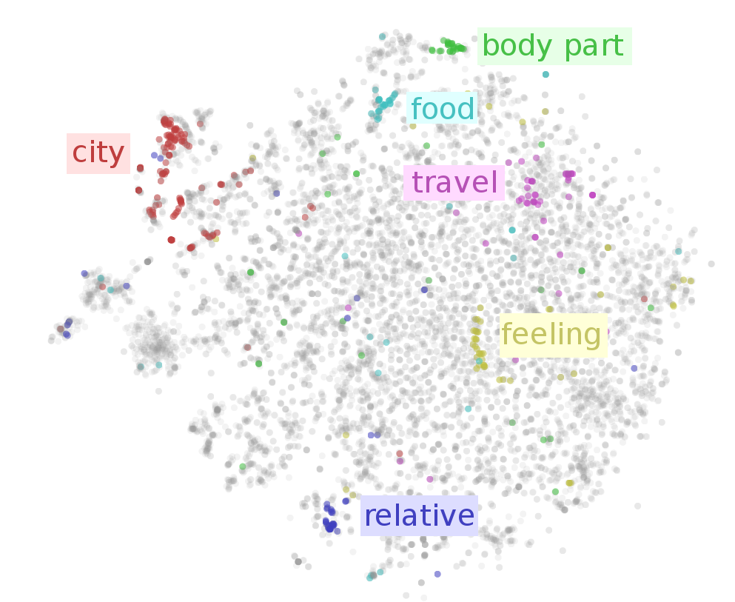
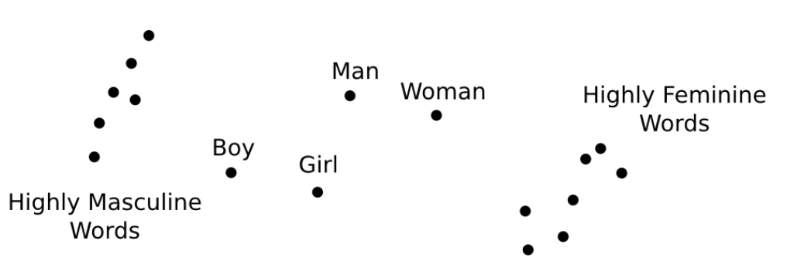
Input Features for NNs: Word Embedding Vectors!
0
0
1
0
0
0
0
E =
W^{T}
“the”
X
Vector for “the”
Images from Visualizing Representations (Chris Olah, 2015)

Slide 9
Input Features for NNs: Word Embedding Vectors!
0
0
1
0
0
0
0
E =
W^{T}
“the”
X
Vector for “the”
Images from Visualizing Representations (Chris Olah, 2015)

Slide 10
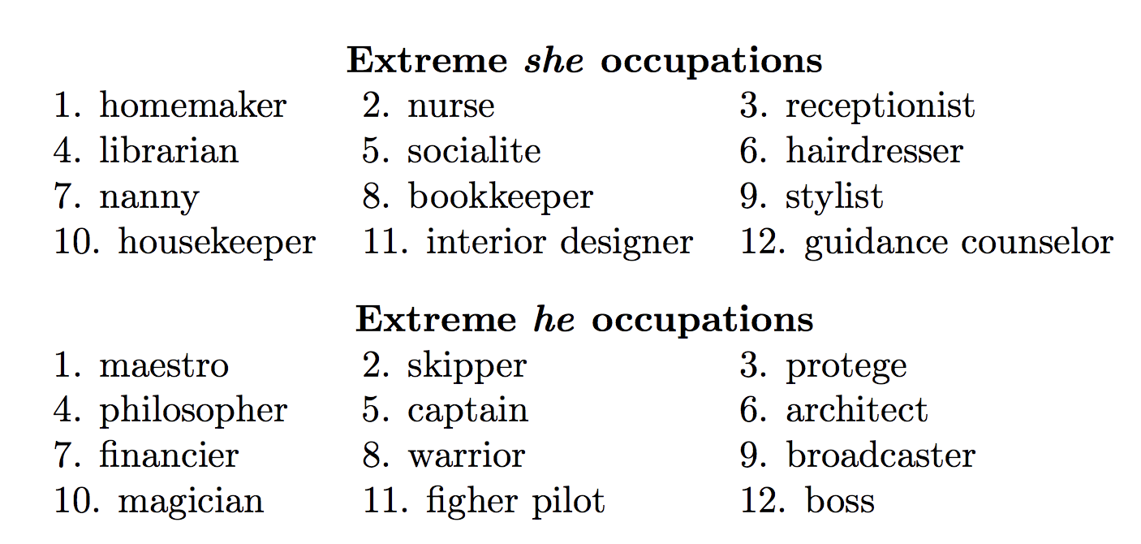
All Is Not Good: Model Bias
Biased data results in biased representations Model representations capture stereotypes (e.g., gender, racial) and implicit biases in language usage.
Representations can be used to study biased language
Debiasing Critical for fairness in downstream applications Identify and adjust representations to eliminate or soften
Key Idea Identify subspace that captures bias Ensure differences between neutral words do not differ (or minimal differ) due to biased subspace
http://blog.conceptnet.io/posts/2017/how-to-make-a-racist-ai-without-really-trying/
Bolukbasi et al. 2016

Slide 11
Another Problem
What about:
“She had quite a fall when she tripped.”
“That hair was allowed to fall on the shoulders.”
“He had a fall out with his folks.”
“The first fall on the hike was really great!”
“That fall Roosevelt was elected.”
Goal: specific embedding for the given context
Let’s get to work...
Just one embedding vector for the word ‘fall’?

Slide 12
Language Models: Motivation & Intuition

Slide 13
Why Language Models?
Example Problem:
“What did the user intend to type when she actually typed ‘Have a nice say!’ ?‘’
Formulation: P(intended | typed) = …? Difficult! Why?

Slide 14
Why Language Models?
Example Problem:
“What did the user intend to type when she actually typed ‘Have a nice say!’ ?‘’
Formulation: P(intended | typed) = …? Difficult! Why?
Which ‘intended’ should be evaluated? A myriad of theoretical options...
Needs to be re-evaluated for each ‘typed’!
Better: Noisy Channel Model: P(intended | typed) ∝ P(typed | intended) x P(intended)

Slide 15
Why Language Models?
Example Problem:
“What did the user intend to type when she actually typed ‘Have a nice say! ’?‘’
Formulation: P(intended | typed) = …? Difficult!
Which ‘intended’ should be evaluated? A myriad of theoretical options...
Needs to be re-evaluated for each ‘typed’!
Better: Noisy Channel Model: P(intended | typed) ∝ P(typed | intended) x P(intended)
The Language Model! Calculated upfront

Slide 16
Why Language Models?
Example Problem:
“What did the user intend to type when she actually typed ‘Have a nice say! ’?‘’
Formulation: P(intended | typed) = …? Difficult!
Which ‘intended’ should be evaluated? A myriad of theoretical options...
Needs to be re-evaluated for each ‘typed’!
Better: Noisy Channel Model: P(intended | typed) ∝ P(typed | intended) x P(intended)
Much easier… test variations only against ‘intended’ with P(intended) > 0(+)
The Language Model! Calculated upfront

Slide 17
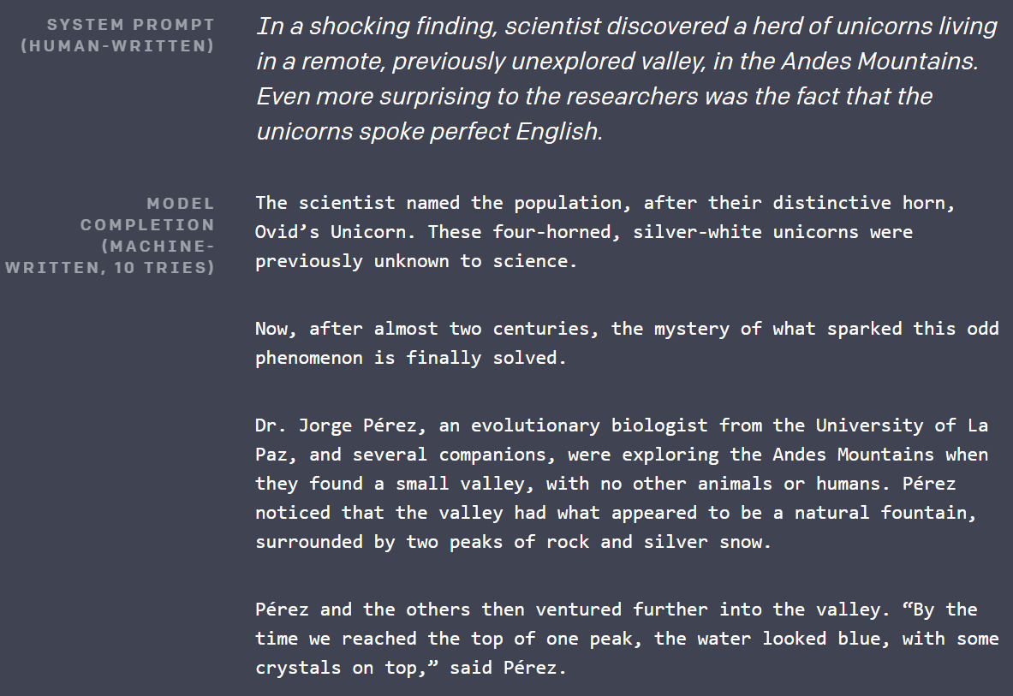
The Language Model
Probability score for a sequence of words
Only based on language, relatively independent of specific use case. Therefore, can be trained on books, web, ...
Can also be used - for fun, not a real use case - to create fake speech
https://blog.openai.com/better-language-models/

Slide 18
Training of Language Model: Intuition
Build LM successively from prior sequences:
Key quantity: “Likelihood that word w_{i} follows the sequence w₁, .., w_{i-1}”
How can we approximate?

Slide 19
Training of Language Model: Intuition
Build LM successively from prior sequences:
Key quantity: “Likelihood that word w_{i} follows the sequence w₁, .., w_{i-1}”
Intuition to get started: Split sentences into tokens… and start counting!
Limit ‘context’ length
Approximate probabilities with observed counts

Slide 20
Training of Language Model: Intuition
Example:
Training Corpus Text:
“Natural Language Processing is a very interesting subject. W266 is a fun class with lots of interesting neural net architectures.”
Question:
What is: P(very|is, a) (without any smoothing)?

Slide 21
Training of Language Model: Intuition
Example:
Training Corpus Text:
“Natural Language Processing is a very interesting subject. W266 is a fun class with lots of interesting neural net architectures.”
Question:
What is: P(very|is, a) (without any smoothing)?
Answer:
P(very|is, a) = c(is,a,very) / c(is, a, *) = 1/2

Slide 22
Training of Language Model: Intuition
Issues:
Forgetfulness - How large should the context window be?
Sparsity - no learning from ‘London’ contexts for ‘Shanghai’ contexts!
Complexities with rare observations: If “my Lamborghini” not in training set… … should p(Lamborghini|my) = 0? Probably not really... Can be improved with various smoothing techniques (see async!):
Add-K
Kneser-Ney (much better!)

Slide 23
Take some time to play...
If you haven’t already, please spend some time looking through...
https://github.com/datasci-w266/2021-spring-main/blob/master/materials/simple_lm/lm1.ipynb

Slide 24
Language Models: A First Neural Model

Slide 25
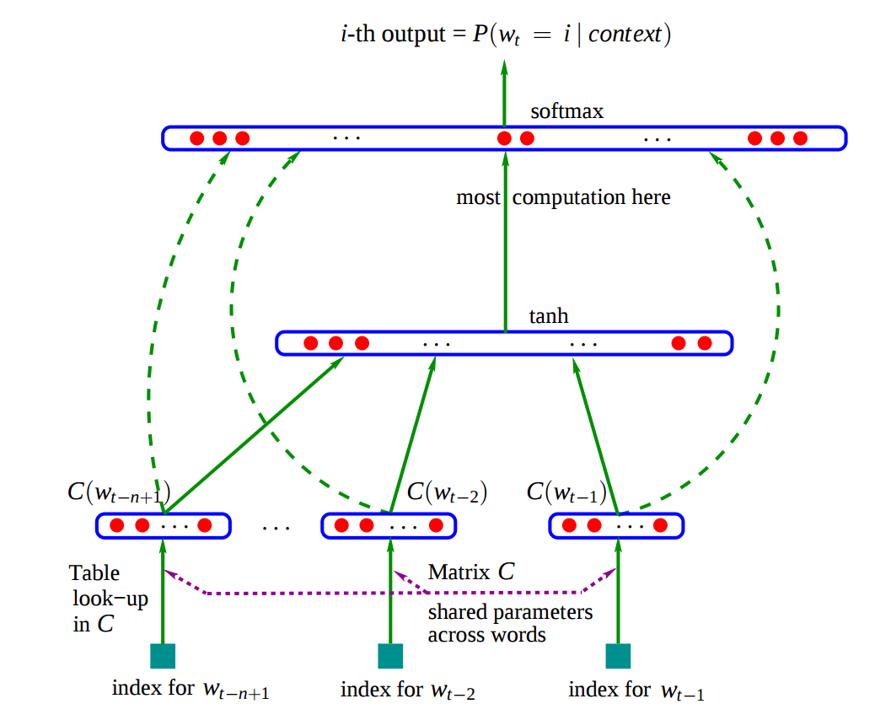
Feed Forward Neural Language Model
Neural Probabilistic Language Model (NPLM) (Bengio et al. 2003)
Softmax Output
Concatenated Embeddings
E
E
E
Context Word i-3
Context Word i-2
Context Word i-1

Slide 27
Window Models
Generic architecture
Useful for language modeling, tagging and entity recognition
Advantages of neural window models?
No issues with sparsity anymore!
Can generalize between two tokens that are nearly the same
Fast to train and use.
Softmax Output
Concatenated Embeddings
E
E
E
Context Word i-3
Context Word i-2
Context Word i-1

Slide 28
Window Models
Generic architecture
Useful for language modeling, tagging and entity recognition
Limitations of Window Models?
Blind to Input Text Outside of Window Text outside of the fixed window is ignored when making predictions.
Ignores Surrounding Predictions Predictions for the prior and next sequence predictions don't inform current position.*
No Modeling of Whole Sequence Level Information Makes no attempt to integrate information across a sequence and use it for making predictions.
Softmax Output
Concatenated Embeddings
E
E
E
Context Word i-3
Context Word i-2
Context Word i-1
* "Window models" that used predictions from prior positions can be characterized as an RNN.

Slide 29
NPLM: Jupyter notebook
https://github.com/datasci-w266/2021-spring-main/blob/master/materials/nplm/nplm.ipynb

Slide 30
Some Alternate Language Model Tasks
Pairwise Ranking Model
Rank correct phrase over phrase with randomly inserted word (Senna)
Masked Language Models (MLM/CLOZE)
Predict masked word in sentence (BERT)
Predict missing phrase/span in sentence (spanBERT)
Replaced Token Detection (RTD)
Predict replaced vs. original token (Electra)

Slide 31
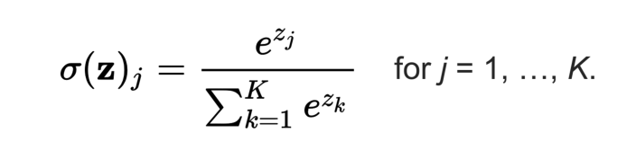
Oh… One More Thing: Optimizations
A language model is a classifier: P(next word | previous words).
Challenge:
Softmax can get really expensive for normal vocabulary size!
Need to sum all exp(z_{i})! How many K?

Slide 32
Softmax Optimizations
Distributed Representations of Words and Phrases and their Compositionality Mikolov et al. (2013)
Negative Sampling: “Approximate cross-entropy minimization by sampling from words”
Hierarchical Softmax: “Reduce compute cost by modeling ‘correct word’ probabilities much more efficiently”
See Also: http://ruder.io/word-embeddings-softmax/ and https://jalammar.github.io/illustrated-word2vec/

Slide 33
Cross-Entropy calculation
Assume the correct class is “j”:

Slide 34
Negative Sampling: Lazy softmax
Approximation - Use Negative Sample (only during training!):
Notes:
Empirically found unigram ^ ¾ to be a good distribution to use; power < 1 gives a bit less weight to really common words that are less useful as contrast.

Slide 35
Negative Sampling: Lazy softmax
Approximation - Use Negative Sample (only during training!):
“Push parameters during training to favor the correct word and disfavor a sample of negative words”
Sample a subset of incorrect responses - only compute a few z_{i}.
Approximate the error function
How to sample? Use a modified unigram distribution
Notes:
Empirically found unigram ^ ¾ to be a good distribution to use; power < 1 gives a bit less weight to really common words that are less useful as contrast.

Slide 36
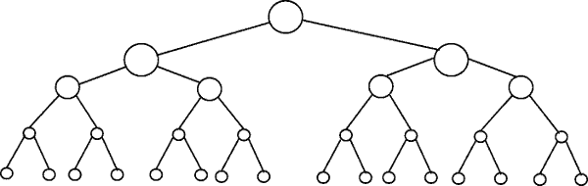
Hierarchical Softmax
Idea:
Organize words as leaf nodes of binary tree
Model probabilities to go right/left from root node and inner nodes to word of interest. (Use output h of last hidden layer...)
n₁
n₂
n₃
n₄
the
and
for
of
cat
dog
...

Slide 37

Hierarchical Softmax: Modeling
n₁
n₂
n₃
n₄
the
and
for
of
cat
dog
...
Create a vector v_{i} for each internal node
Output of last hidden layer
“Node vector”

Slide 38
Hierarchical Softmax: Modeling
Questions:
What is the one-hot cross-entropy? What’s the run-time for p(dog) ?
Number of parameters (dim(W) = w)?

Slide 39
Hierarchical Softmax: Modeling
Questions:
What’s the run-time for p(dog) ? log(|V|) terms instead of |V|.... O(log(|V|)) run time to find p(dog)!
Number of parameters (dim(W) = w)?

Slide 40
Hierarchical Softmax: Modeling
Questions:
What’s the run-time for p(dog) ? log(|V|) terms instead of |V|.... O(log(|V|)) run time to find p(dog)!
Number of parameters (dim(W) = w)?
O(H x V) (similar to standard affine/softmax!)
W

Slide 41
Hierarchical Softmax: Word Arrangement
the
and
for
of
cat
dog
...
Ways to build the tree & structure word arrangements:
Huffman Tree
WordNet
Word Clustering

Slide 42
Language Models: A Very Large Neural Model

Slide 43
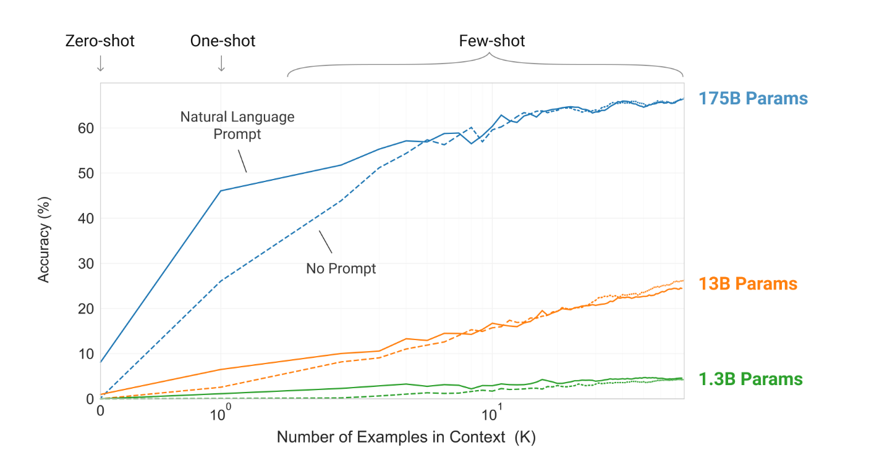
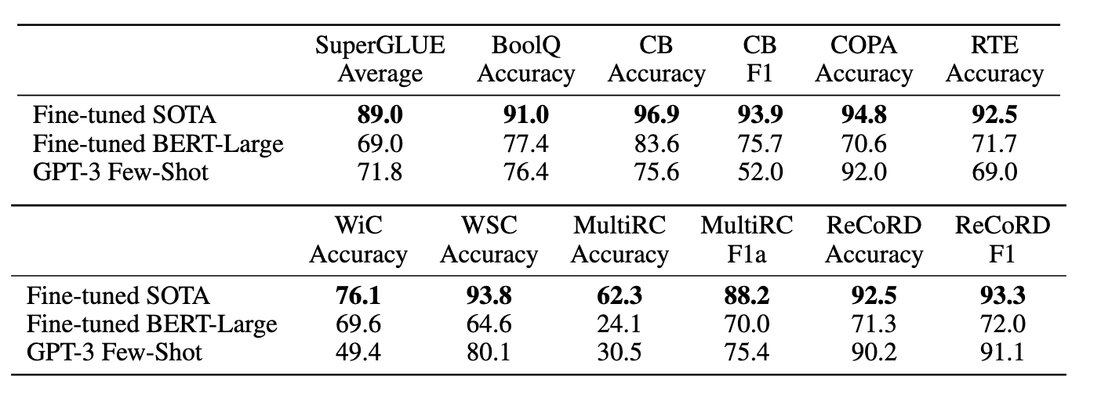
SOTA: Open AI’s GPT-3 “Language Models are Few-Shot Learners”
Huge Language Model - 175 bn parameters
2048 word window
Excellent Few-Shot performance for many tasks
Still some surprising limitations in various critical tasks like language inference:
“A more fundamental limitation of the general approach described in this paper – scaling up any LM-like model, whether autoregressive or bidirectional – is that it may eventually run into (or could already be running into) the limits of the pretraining objective.”
Source Paper: https://arxiv.org/pdf/2005.14165.pdf

Slide 45
Appendix

Slide 46
Sampled Softmax
(bias term not shown)
Target y
(single integer)
Weight matrix W
Shape = [H,V]
num_samples indices selected at random
Sampled W’
Shape = [H, num_samples+1]
Vector h
Shape = [1,H]
Sampled logits z’
Shape = [1,num_samples+1]
·
=

